Slide 1
Introduction PhoneGap
26-Jul-2011

Slide 2
Agenda
History
Partners / Contributors
What is PhoneGap?
Native API
PhoneGap API
Demo Hello World
PhoneGap Build

Slide 3
History
2005-2010, Nitobi Software Inc.
2010-2011, IBM Corporation.
2008, MIT License
Notes:
PhoneGap is a sponsored project of Nitobi (http://nitobi.com).

Slide 4
Partners / Contributors
Nitobi
IBM
Sony Ericssion
Symbian
Palm
RIM
Sencha

Slide 5
What is PhoneGap?
PhoneGap is a standards-based, open-source development framework for building cross-platform mobile apps with HTML, CSS and JavaScript for iPhone/iPad, Google Android, Palm, Symbian, BlackBerry, Windows Mobile and more.
PhoneGap provides a rich collection of client-side JavaScript APIs.
Notes:
https://build.phonegap.com/

Slide 6
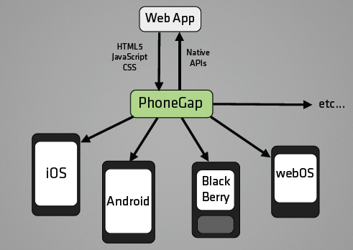
What is PhoneGap?

Slide 7
Native API
Device identification
Network access
Sensors
Geo, Accelerometer, Orientation, Magnetometer
Camera / Image sources
Contacts
File access

Slide 8
PhoneGap API
http://www.phonegap.com/about/features
http://docs.phonegap.com/

Slide 9
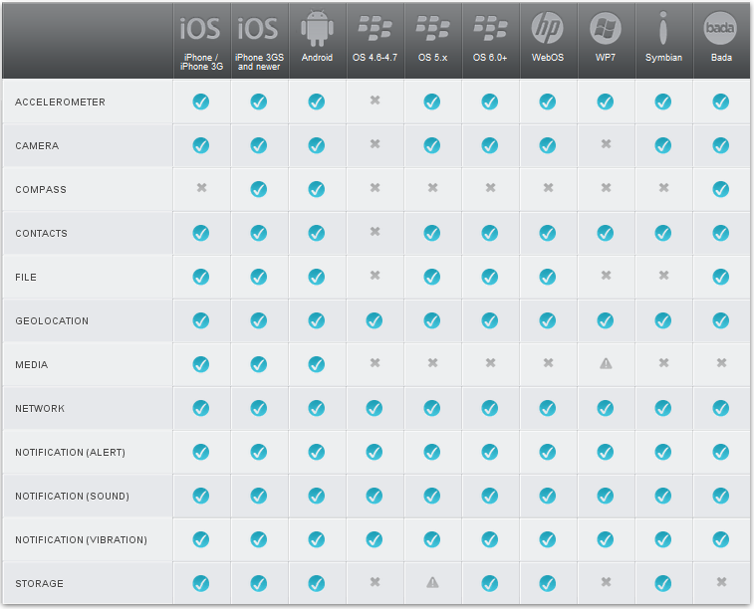
Notes:
http://www.phonegap.com/about/features
http://docs.phonegap.com/

Slide 10
Demo Hello world
http://www.phonegap.com/start

Slide 11
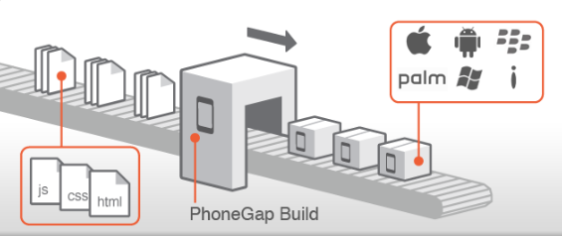
PhoneGap Build
Notes:
http://www.youtube.com/watch?v=E3--Yq23v_Y

